Slide 1

Salary Predictions based on Demographic factors and Experience
Presented by:
Basudeb Ghosh
Hieu Nghia Doan
Jai Gupta
Sandhalie Fernando
Notes:
Jai Slide 1

Slide 2



Target Audience
Job Seekers
Recruitment Agencies
Talent Acquisition Teams of Corporates
Notes:
Jai Slide 2

Slide 3

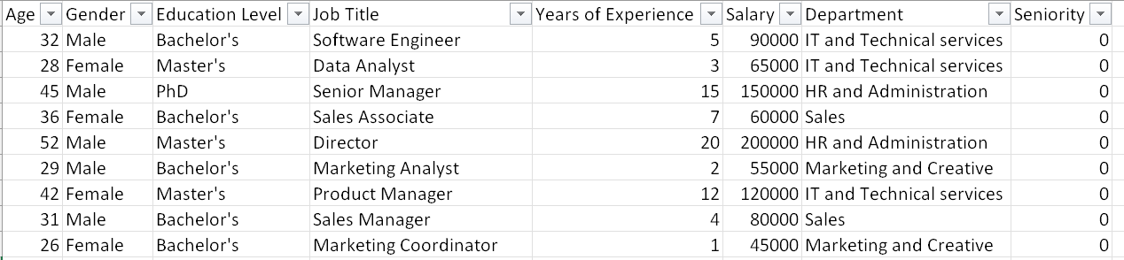
DATASET USED AND BIASES MINIMIZATION
To ensure fairness and eliminate potential biases, we have made a deliberate decision to exclude age and gender from our predictive model.
Notes:
Jai Slide 3

Slide 4
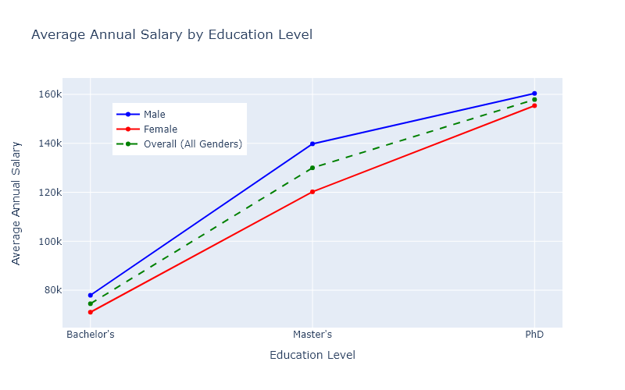
Annual Salary vs. Education
Notes:
Basu Slide 1

Slide 5
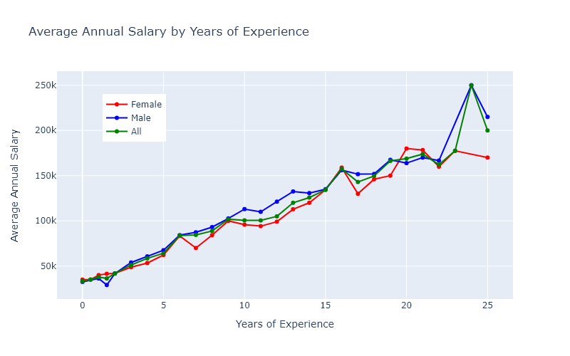
Annual Salary vs. Years of Experience
Notes:
Basu Slide 2

Slide 6
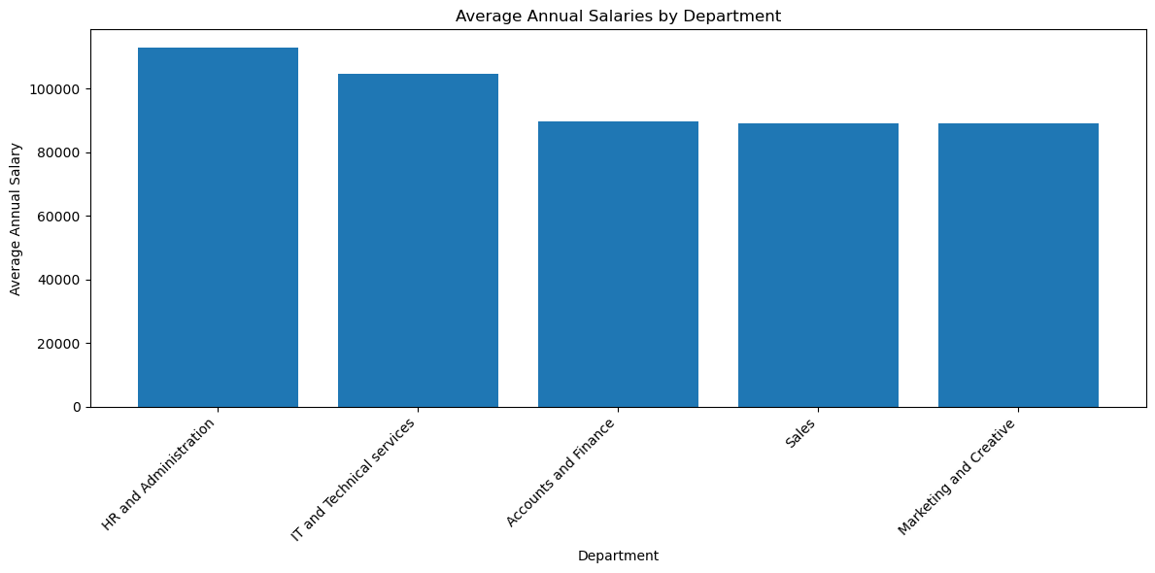
Average Salary by Department
Notes:
Basu Slide 3

Slide 7
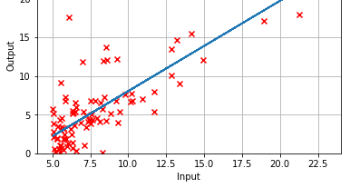
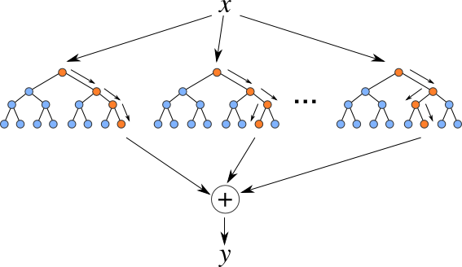
MACHINE LEARNING MODEL
Dependent variable: Salary.
Independent variables: age, gender, education levels,
job title, years of experience , department and seniority.
Multiple Linear Regression Model:
R²: 0.903, Mean Squared Error: 233355401
Random Forest Model:
R²: 0.846, Mean Squared Error: 368558692
Notes:
Sandhalie Slide 1

Slide 8
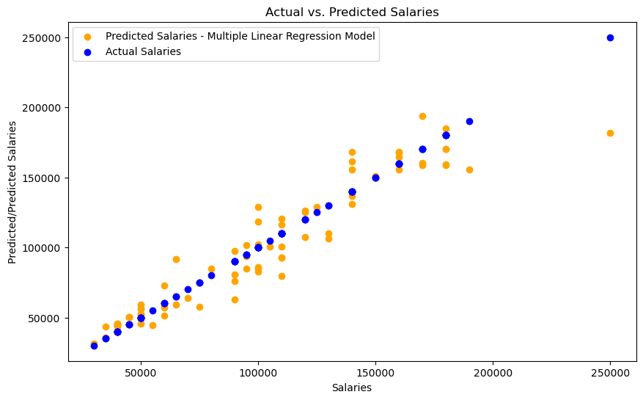
Notes:
Sandhalie Slide 2

Slide 9
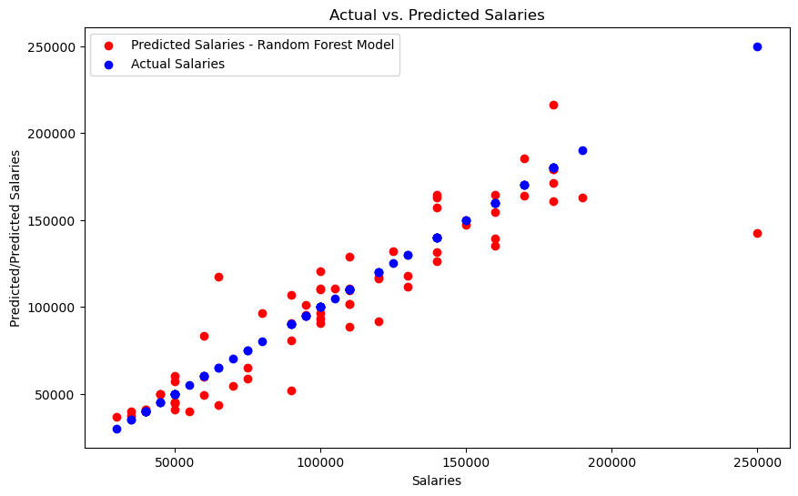
Notes:
Sandhalie Slide 3

Slide 10
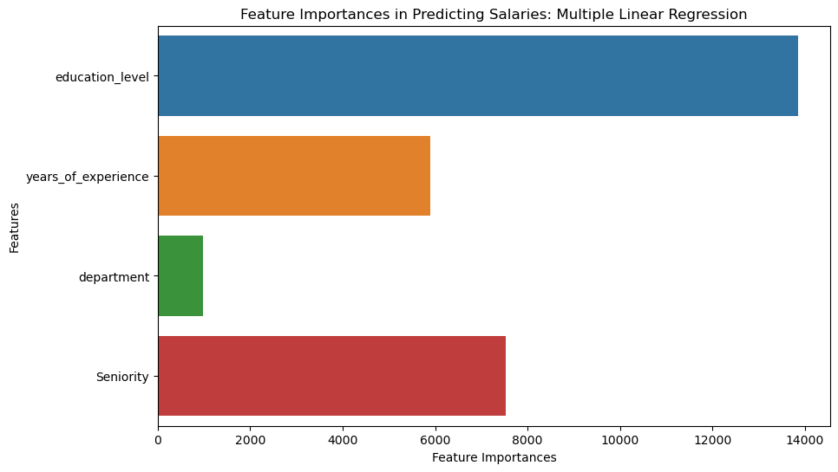
Feature Importance: Multiple Linear Regression
Notes:
Sandhalie Slide 4

Slide 11
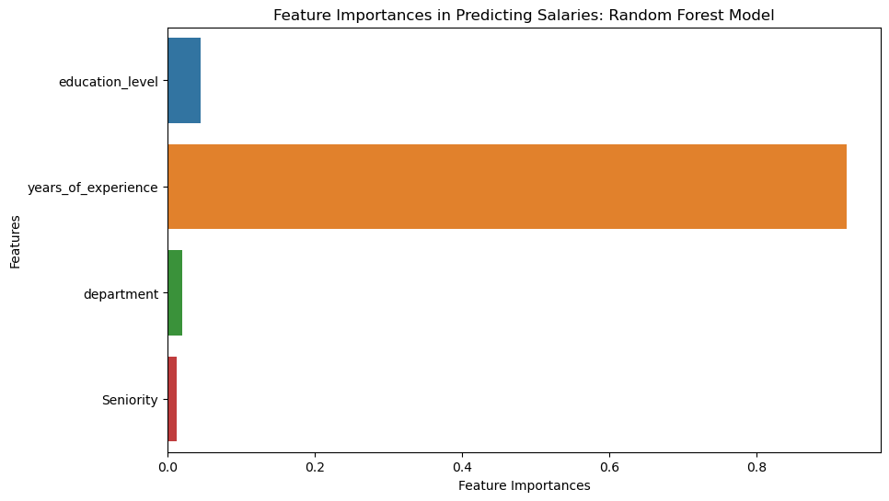
Feature Importance: Random Forest Model
Notes:
Sandhalie Slide 5

Slide 12

Limitations and Future Enhancements
Limitations
User friendliness barrier
Bias and Fairness
Scalability
Enhancements
Interactive, user-friendly website
Diverse data collection
Cloud computing
Notes:
Vincent Slide 1

Slide 13

Notes:
Vincent Slide 2

Slide 14
Thank you.

